Slide 1


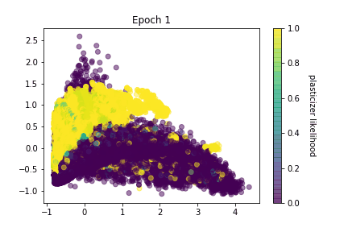
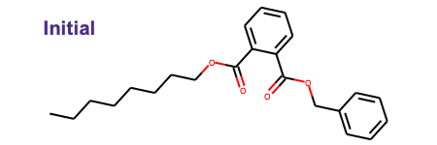
Generative Neural Nets for Plasticizer Prediction
Team: Orion Dollar, Nisarg Joshi, Yunping Huang
Sponsor: Cargill

Slide 2
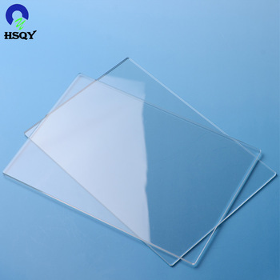
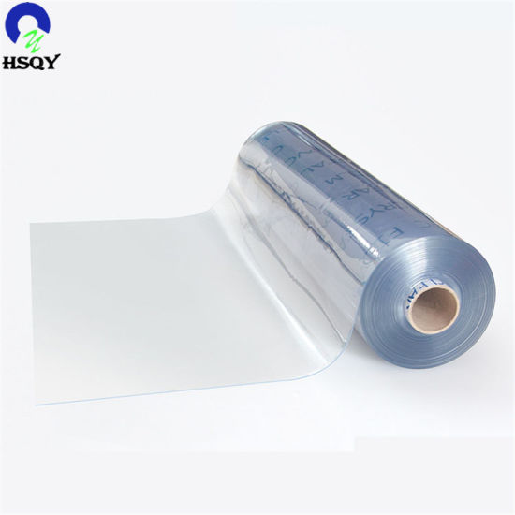
What are plasticizers?
It is an additive added into plastics to increase their plasticity and processability
Plasticizer
Hard plastic
Flexible plastic

Slide 3


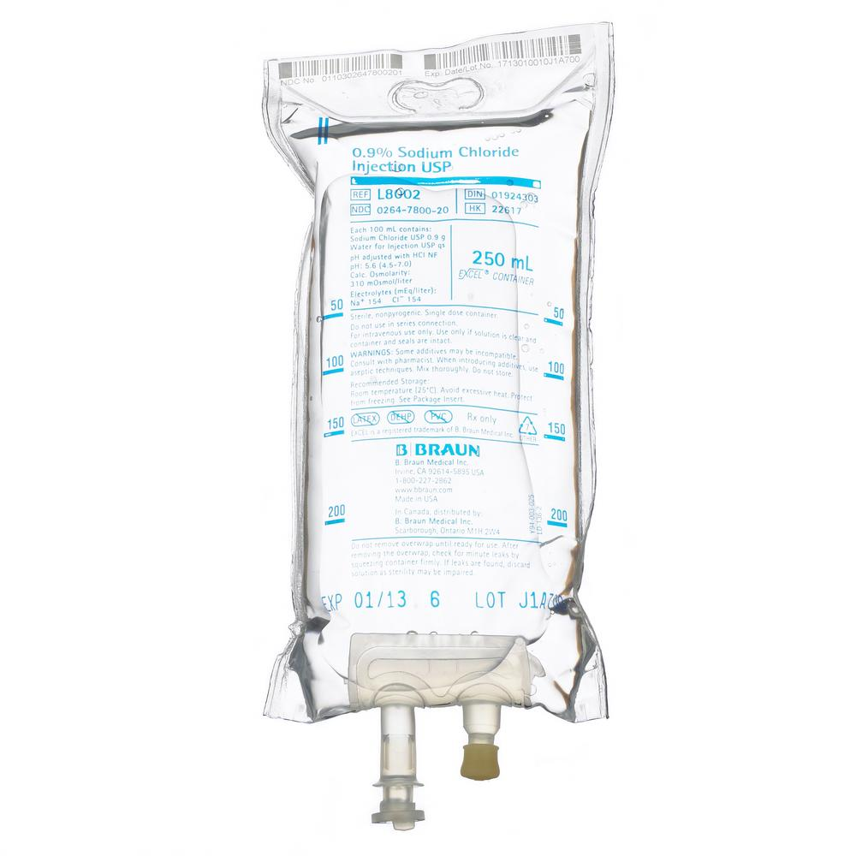

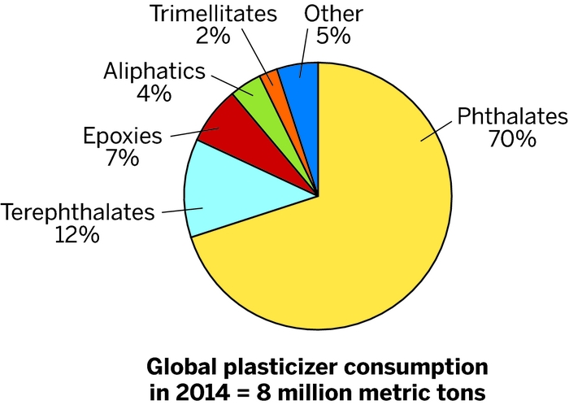
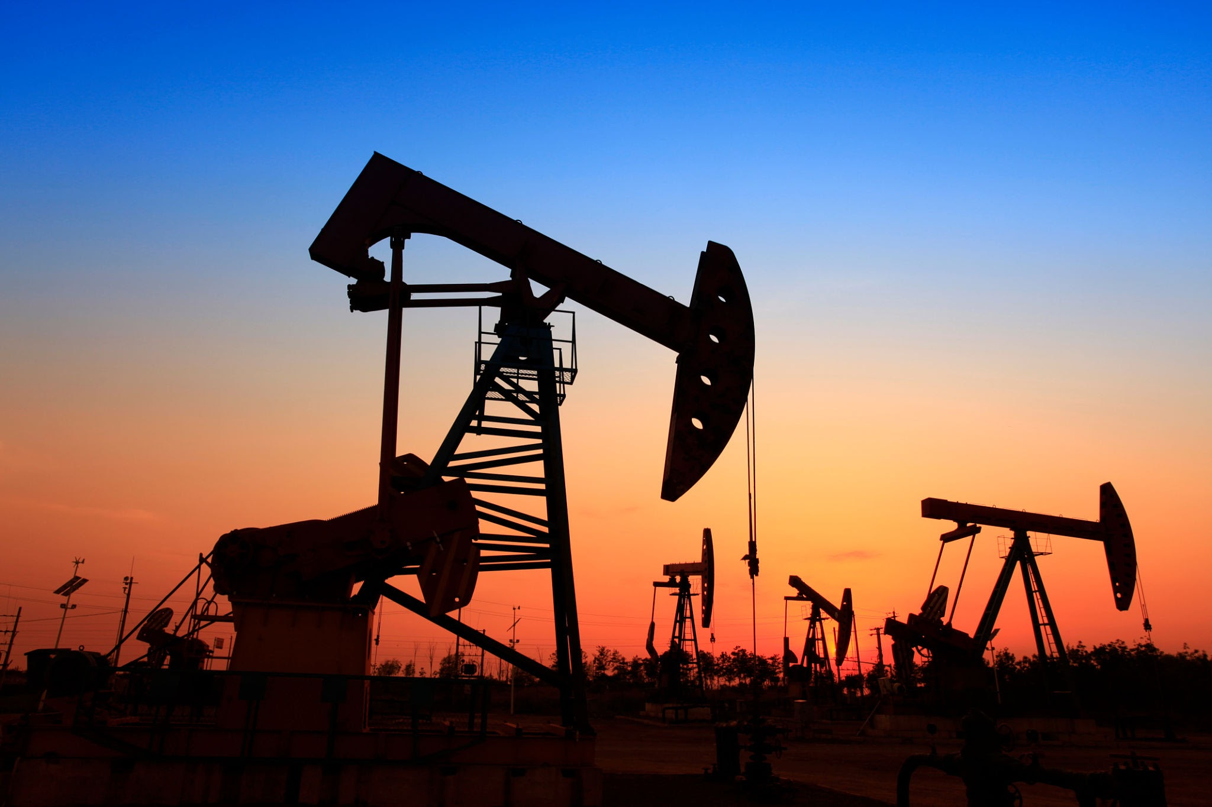
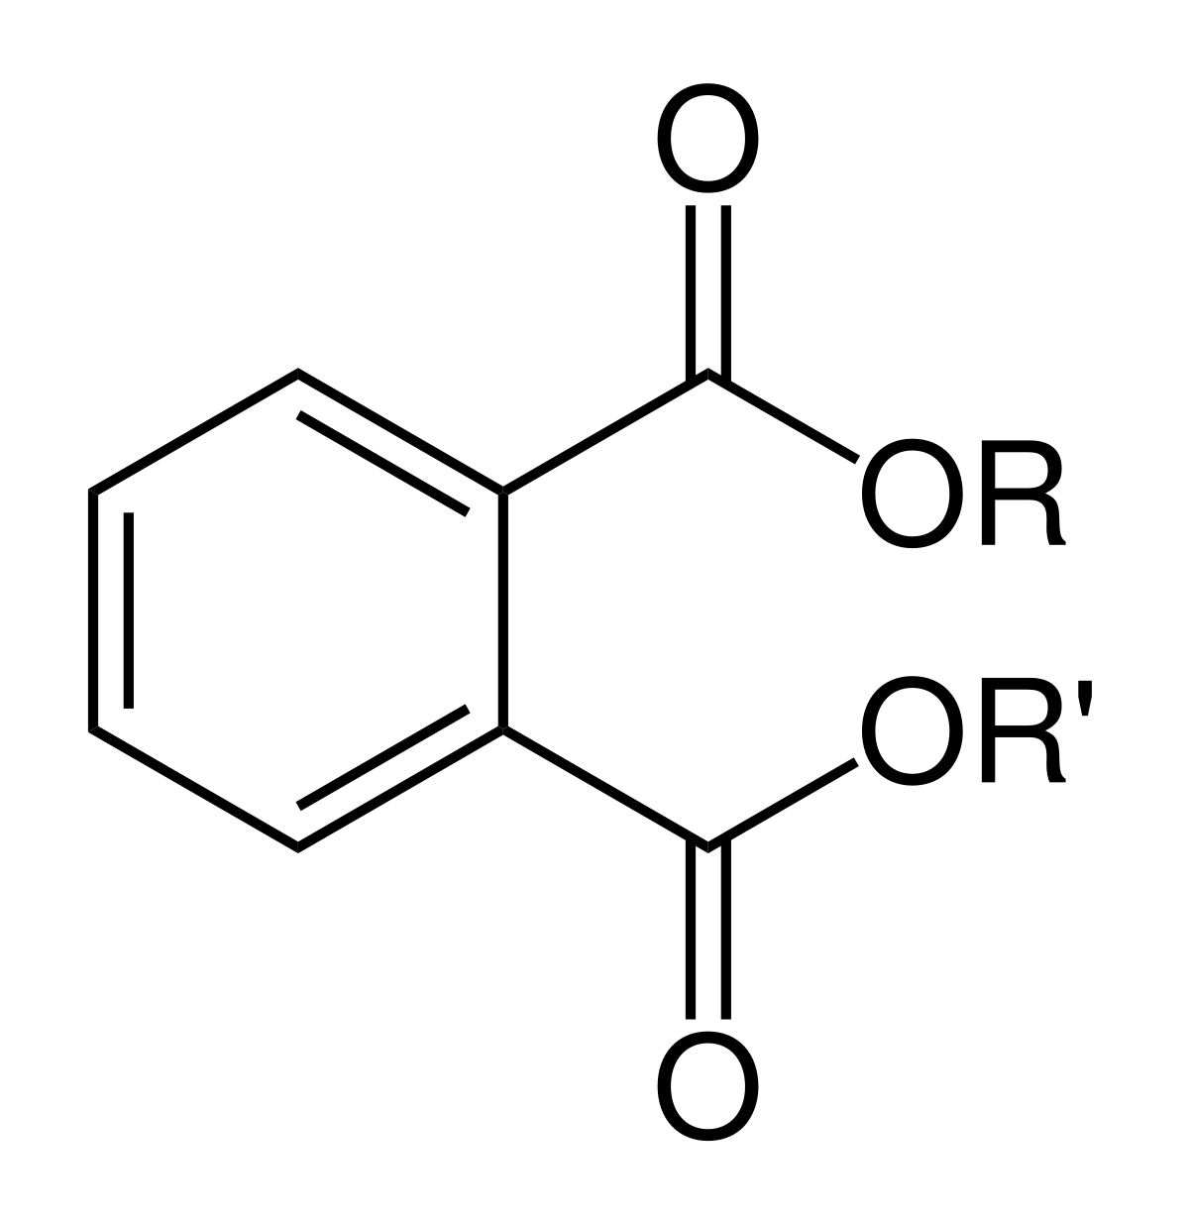
Current challenges
The most used plasticizer, phthalates raise concerns regarding toxicity and depletion
Reproductive
hazardous
Carcinogenic
In toys
In medical devices
Toxic but widely used
Phthalate
Phthalates are down-stream products in petroleum industry

Slide 4
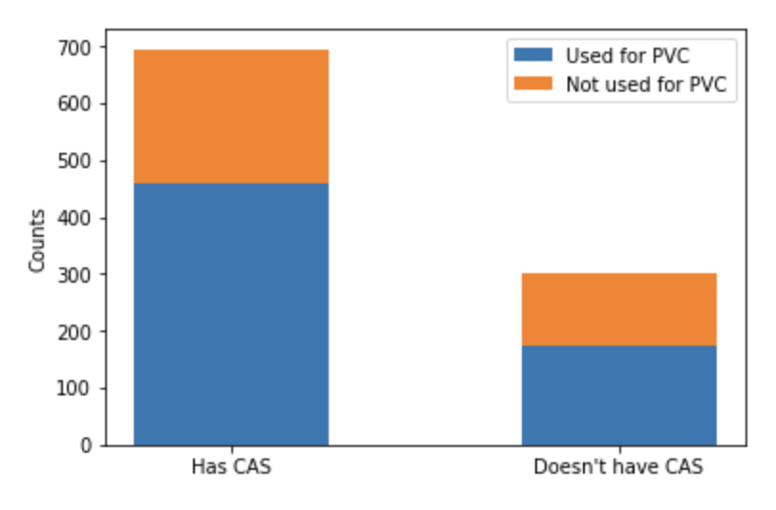
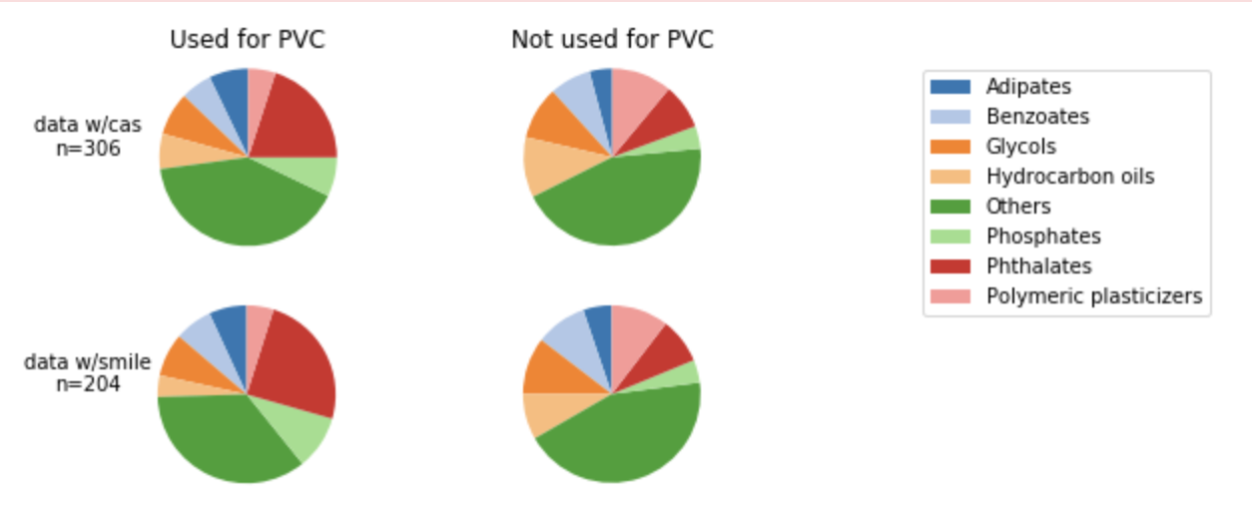
Plasticizer Data
PubChem
All plasticizer samples from Knovel sources
Samples with CAS No.
Removing duplicates
Samples with SMILES
45,000+ organic molecules from PubChem database
Filtered to remove molecules with charged moieties
n=1257
n=845
n=306
n=187
GDB-17
Enumerated dataset of molecules with up to 17 atoms
5,000,000 selected from full dataset which contains billions of samples

Slide 5
Two-Pronged Approach
Prediction
Generation
Logistic Regression w/LASSO
Variational Autoencoder
CCCCCOC(=O)CCC(=O)O
BrC1=C(NC(=O)C=C1)OCCOCCOC=N
C1=C(C2CO2)S(=O)(=O)C2=C(OCCO2)S1
BrC1=C2CC3(COCCO3)C(C=O)C2=CC=N1
C(=O)N1CCOC=O…
SMILES strings

Slide 6
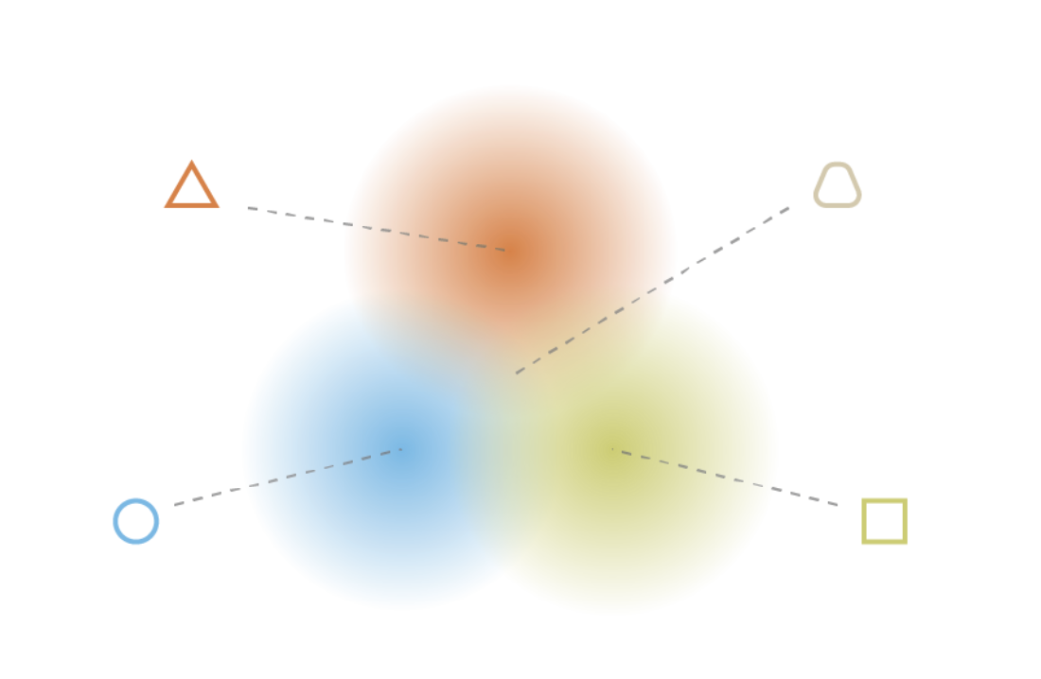
Two-Pronged Approach
Prediction
Generation
Logistic Regression w/LASSO
Variational Autoencoder
Numerical Representation
of Molecular Structure
CCCCCOC(=O)CCC(=O)O
BrC1=C(NC(=O)C=C1)OCCOCCOC=N
C1=C(C2CO2)S(=O)(=O)C2=C(OCCO2)S1
BrC1=C2CC3(COCCO3)C(C=O)C2=CC=N1
C(=O)N1CCOC=O…
SMILES strings

Slide 7
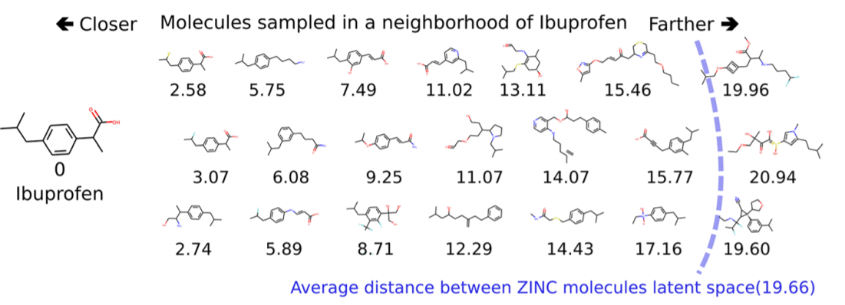
Two-Pronged Approach
Prediction
Generation
Logistic Regression w/LASSO
Variational Autoencoder
Numerical Representation
of Molecular Structure
CCCCCOC(=O)CCC(=O)O
BrC1=C(NC(=O)C=C1)OCCOCCOC=N
C1=C(C2CO2)S(=O)(=O)C2=C(OCCO2)S1
BrC1=C2CC3(COCCO3)C(C=O)C2=CC=N1
C(=O)N1CCOC=O…
SMILES strings
Structure Interpolation

Slide 8
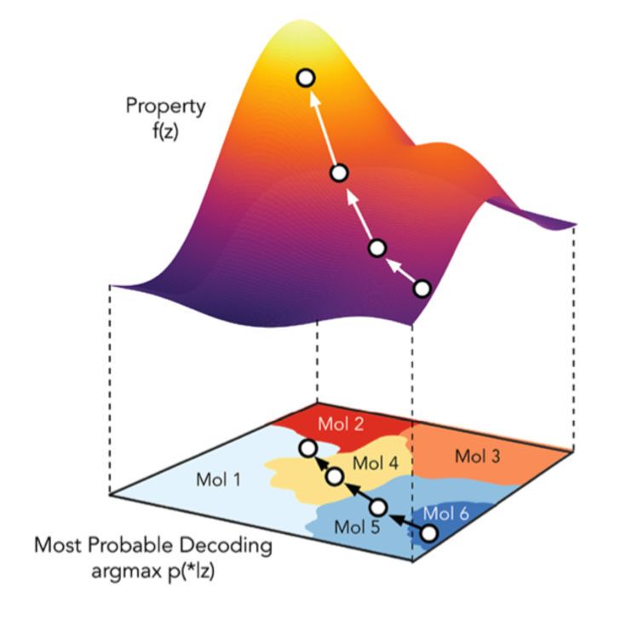
Two-Pronged Approach
Prediction
Generation
Logistic Regression w/LASSO
Variational Autoencoder
Numerical Representation
of Molecular Structure
CCCCCOC(=O)CCC(=O)O
BrC1=C(NC(=O)C=C1)OCCOCCOC=N
C1=C(C2CO2)S(=O)(=O)C2=C(OCCO2)S1
BrC1=C2CC3(COCCO3)C(C=O)C2=CC=N1
C(=O)N1CCOC=O…
SMILES strings
Property Optimization
Structure Interpolation

Slide 9
Two-Pronged Approach
Prediction
Generation
Logistic Regression w/LASSO
Variational Autoencoder
Physicochemical Feature Generation
Numerical Representation
of Molecular Structure
Chemical Properties
CCCCCOC(=O)CCC(=O)O
BrC1=C(NC(=O)C=C1)OCCOCCOC=N
C1=C(C2CO2)S(=O)(=O)C2=C(OCCO2)S1
BrC1=C2CC3(COCCO3)C(C=O)C2=CC=N1
C(=O)N1CCOC=O…
SMILES strings
Property Optimization
Structure Interpolation

Slide 10
Two-Pronged Approach
Prediction
Generation
Logistic Regression w/LASSO
Variational Autoencoder
Physicochemical Feature Generation
Numerical Representation
of Molecular Structure
Chemical Properties
CCCCCOC(=O)CCC(=O)O
BrC1=C(NC(=O)C=C1)OCCOCCOC=N
C1=C(C2CO2)S(=O)(=O)C2=C(OCCO2)S1
BrC1=C2CC3(COCCO3)C(C=O)C2=CC=N1
C(=O)N1CCOC=O…
SMILES strings
Property Optimization
Feature Selection
Structure Interpolation

Slide 11
Two-Pronged Approach
Prediction
Generation
Logistic Regression w/LASSO
Variational Autoencoder
Physicochemical Feature Generation
Numerical Representation
of Molecular Structure
Chemical Properties
CCCCCOC(=O)CCC(=O)O
BrC1=C(NC(=O)C=C1)OCCOCCOC=N
C1=C(C2CO2)S(=O)(=O)C2=C(OCCO2)S1
BrC1=C2CC3(COCCO3)C(C=O)C2=CC=N1
C(=O)N1CCOC=O…
SMILES strings
Property Optimization
Feature Selection
Prediction Accuracy
Structure Interpolation

Slide 12
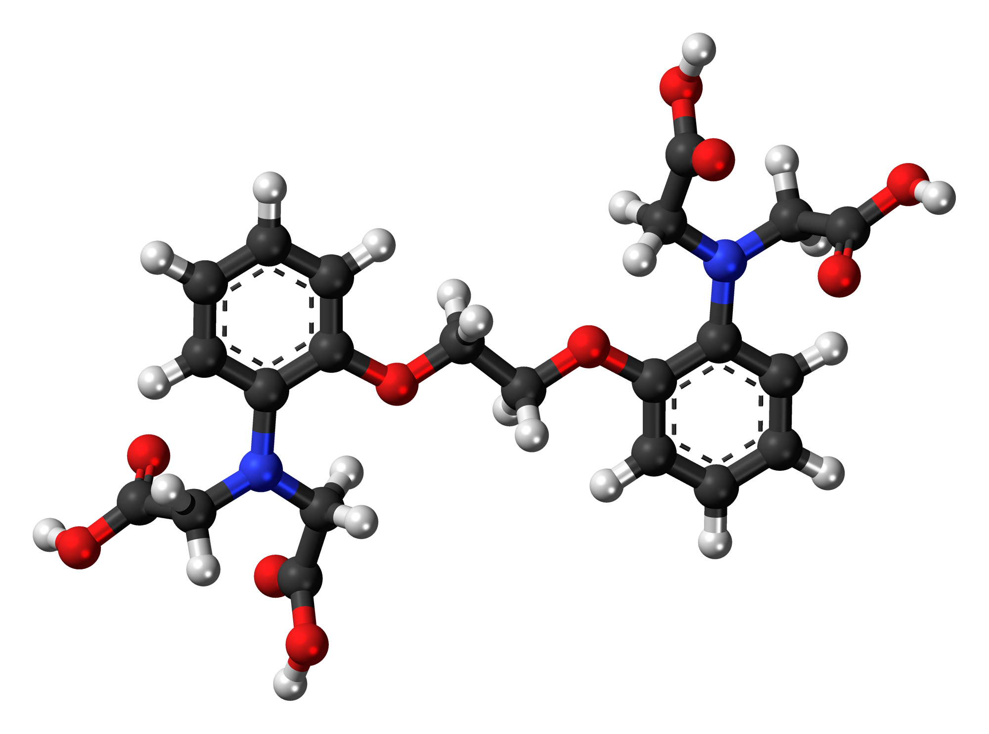
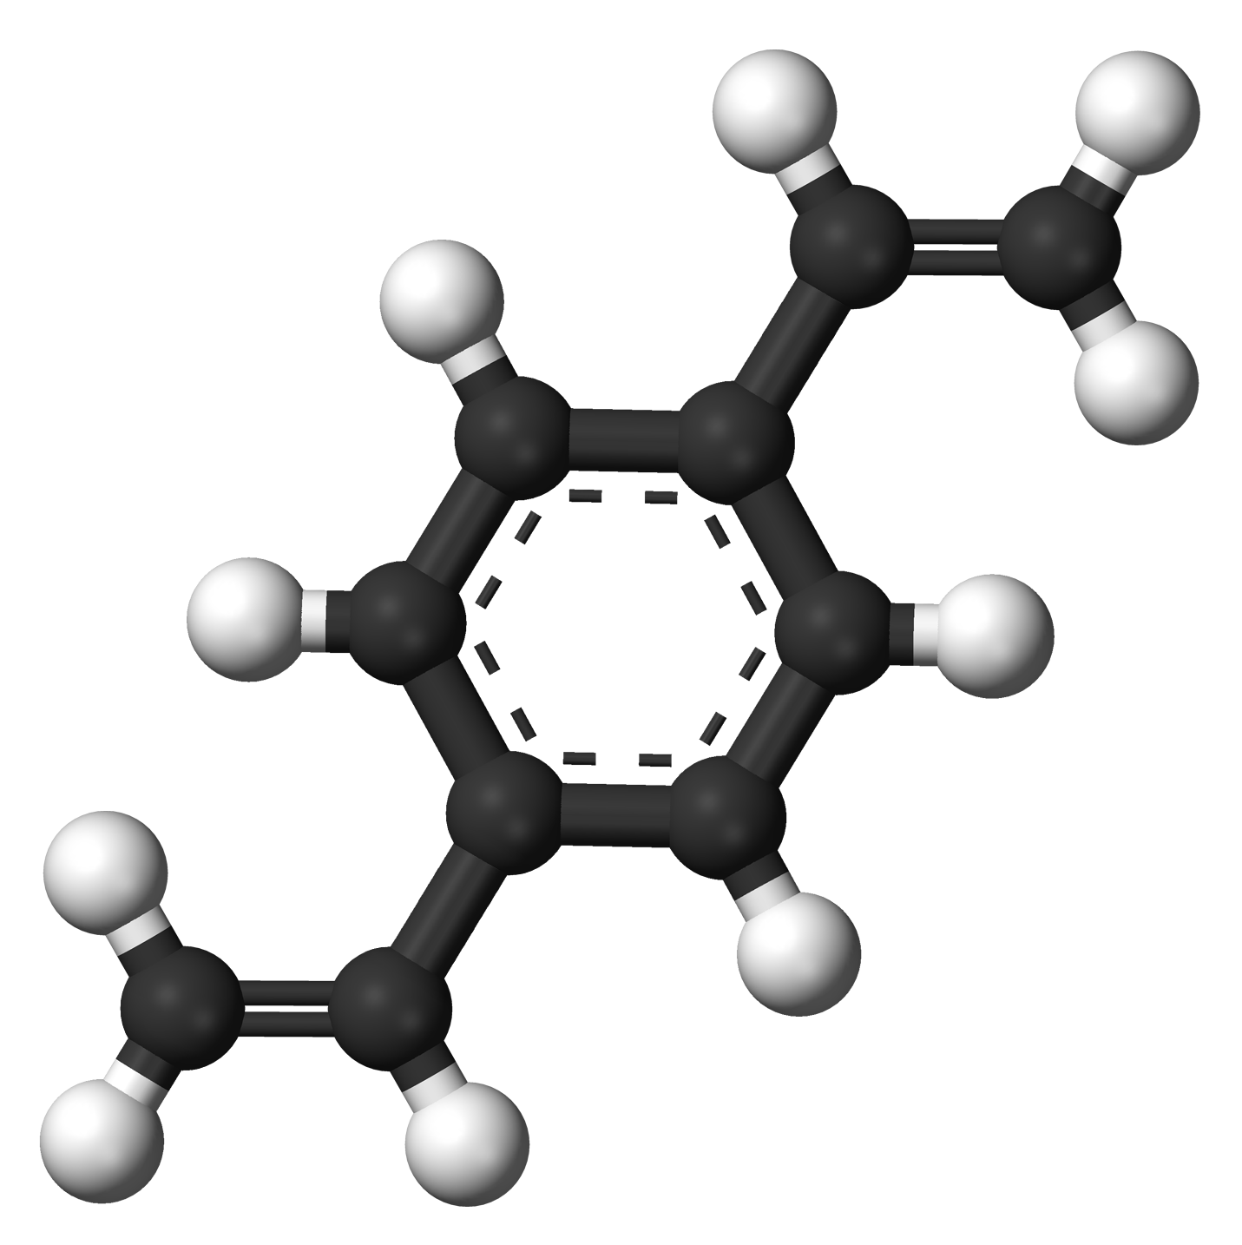
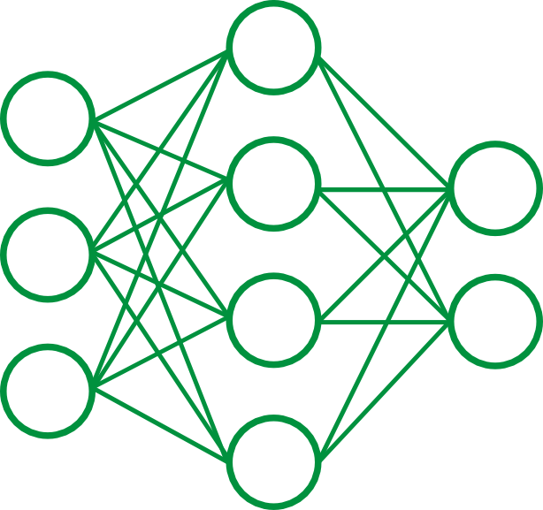

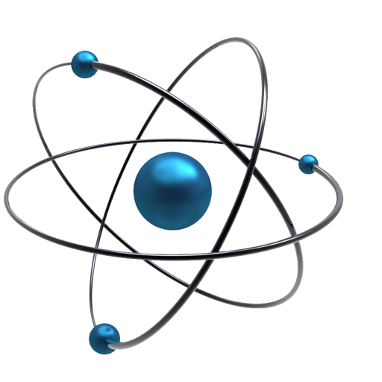
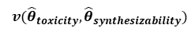
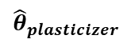
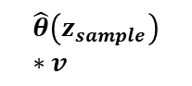
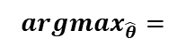
Proposed learning pipeline
Molecular Generation
$${argmax}_{\hat{θ}}=$$
Decoder
Reconstructed
SMILES
SMILES
Encoder
Feature Gen
Property
Predictor
$$v({\hat{θ}}_{toxicity},{\hat{θ}}_{synthesizability})$$
$${\hat{θ}}_{plasticizer}$$
$$\hat{θ}\left(z_{sample}\right)∗v$$

Slide 13
Proposed learning pipeline
Molecular Generation
$${argmax}_{\hat{θ}}=$$
Decoder
Reconstructed
SMILES
SMILES
Encoder
Feature Gen
Property
Predictor
$$v({\hat{θ}}_{toxicity},{\hat{θ}}_{synthesizability})$$
1) Chemical features and its effectiveness as a plasticizer
$${\hat{θ}}_{plasticizer}$$
$$\hat{θ}\left(z_{sample}\right)∗v$$

Slide 14
Proposed learning pipeline
2) Generate new plasticizers
Molecular Generation
$${argmax}_{\hat{θ}}=$$
Decoder
Reconstructed
SMILES
SMILES
Encoder
Feature Gen
Property
Predictor
$$v({\hat{θ}}_{toxicity},{\hat{θ}}_{synthesizability})$$
1) Chemical features and its effectiveness as a plasticizer
$${\hat{θ}}_{plasticizer}$$
$$\hat{θ}\left(z_{sample}\right)∗v$$

Slide 15
Proposed learning pipeline
2) Generate new plasticizers
Molecular Generation
$${argmax}_{\hat{θ}}=$$
Decoder
Reconstructed
SMILES
SMILES
Encoder
Feature Gen
Property
Predictor
$$v({\hat{θ}}_{toxicity},{\hat{θ}}_{synthesizability})$$
1) Chemical features and its effectiveness as a plasticizer
$${\hat{θ}}_{plasticizer}$$
3) Assess the toxicity and synthesizability
$$\hat{θ}\left(z_{sample}\right)∗v$$

Slide 16
Results

Slide 17
Logistic Regression w/LASSO
Non-plasticizer samples selected from set of PubChem organics least similar to plasticizers
Feature definitions:
VSA – Subdivided Surface Areas
PEOE – Partial Equalization of Orbital Electronegativities
SlogP – Octanol/Water Partition Coefficient
EState – Electrotopological State

Slide 18
Sample of High-Scoring Molecules
PubChem
GDB-17
𝞱_{plasticizer} = 0.99950
𝞱_{plasticizer} = 0.99953
𝞱_{plasticizer} = 0.99984
𝞱_{plasticizer} = 0.99998

Slide 19
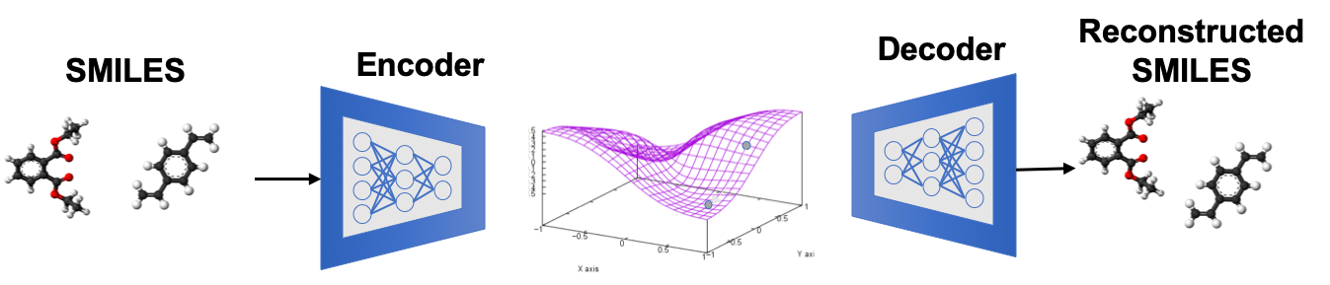
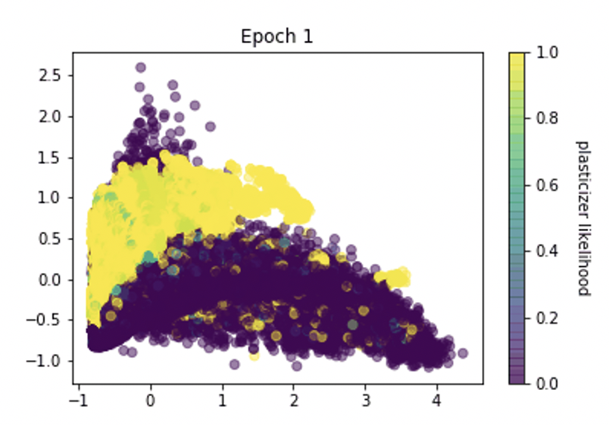
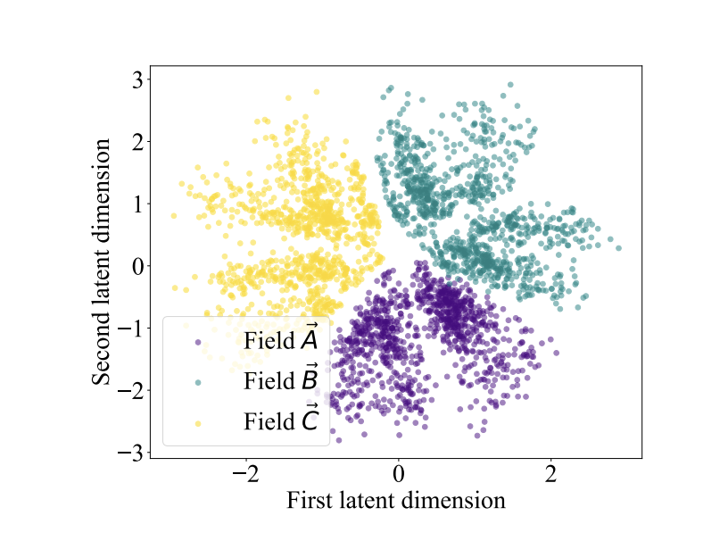
Variational Autoencoder – Property Prediction
Variational Autoencoder – Reconstruction
Property
Predictor
Sample Reconstructions
Target CCCCC(CC)COC(=O)CCCCCC(C)C
Output CCCCC(CC)COC(=O)CCCCCC(C)C
Target CCCCOP(=O)(OCCCC)OCCCC
Output CCCCOP(=O)(OCCCC)OCCCC
Target C(C(CO)(CO)COCC(CO)(CO)CO)O
Output C(C(CO)(CO)COCC(CO)(CO)CO)O
Target CC1=NOC(=C1SC#N)N
Output CC1=C(C(=N1)1=C)N
Target CCC(CC1=CC=C(C=C1)Cl)N
Output CCC(CC1=CC=C(C=C1)O)N
Target C1=CC=C(C(=C1)C(=O)O)N2C(=NC=N2)CC3=CC=C(C=C3)O
Output C1=CC=C(C(=C1)C(=O)N)C2=NC=C(=2)CC3=CC=C(C=C3)O
Target CC1=CC(=C2C3=C1OC4(C=C3C5=C(C2=O)C(=CC(=C5)O)O)C(=O)NC(=CC6=C(NC7=CC=CC=C76)C(C)(C)C=C)C(=O)N4)O
Output CC1=CC(=O2C3=C1CC43C(C4C(=33C(=O)C5=C((=C5O5)O)C()O)OCC(CCC=C(CCCCCCCCC)O)O)O)CCCC=C(C=C(=O)OC)C)C
Target CC1C(C2(C3C4C1(C5C=C(C(=O)C5(C(C6(C4O6)CO)O)O)C)OC(O3)(O2)C7=CC=CC=C7)C(=C)C)OC(=O)C=CC8=CC=CC=C8
Output CCN1CC2(C3C4CC(C5C=C(C(=O)C5(C(C6(C4O6)CO)O)O)C)OC(O3)(O2)C7=CC=CC=C7)C(=C)C)OC(=O)C=CC8CCC=CC=C8
We encode our plasticizer likelihood property into the latent space
Derived from logistic regression model
https://arxiv.org/pdf/2004.03604.pdf

Slide 20
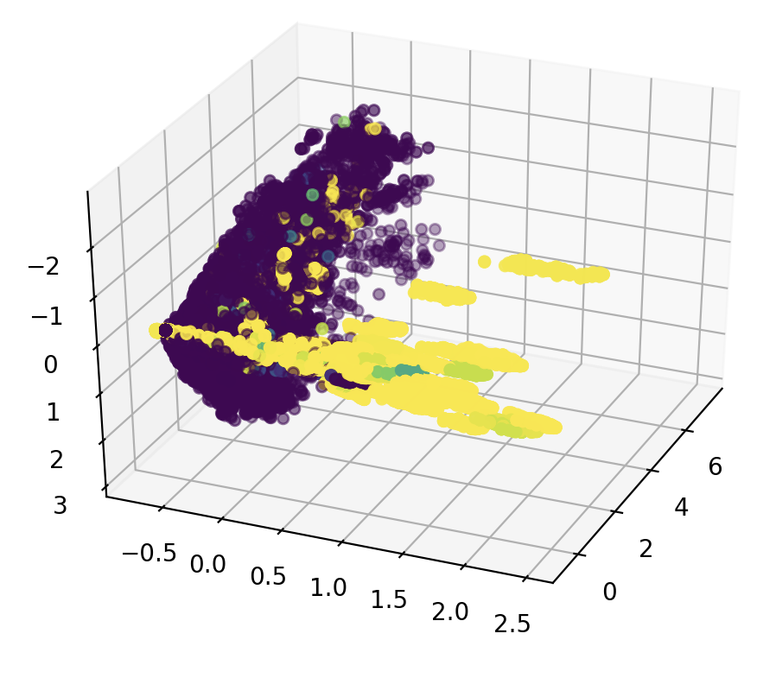
Latent Space Reorganization

Slide 21
Latent Space Reorganization
Interpolating b/w Molecular Structures

Slide 22
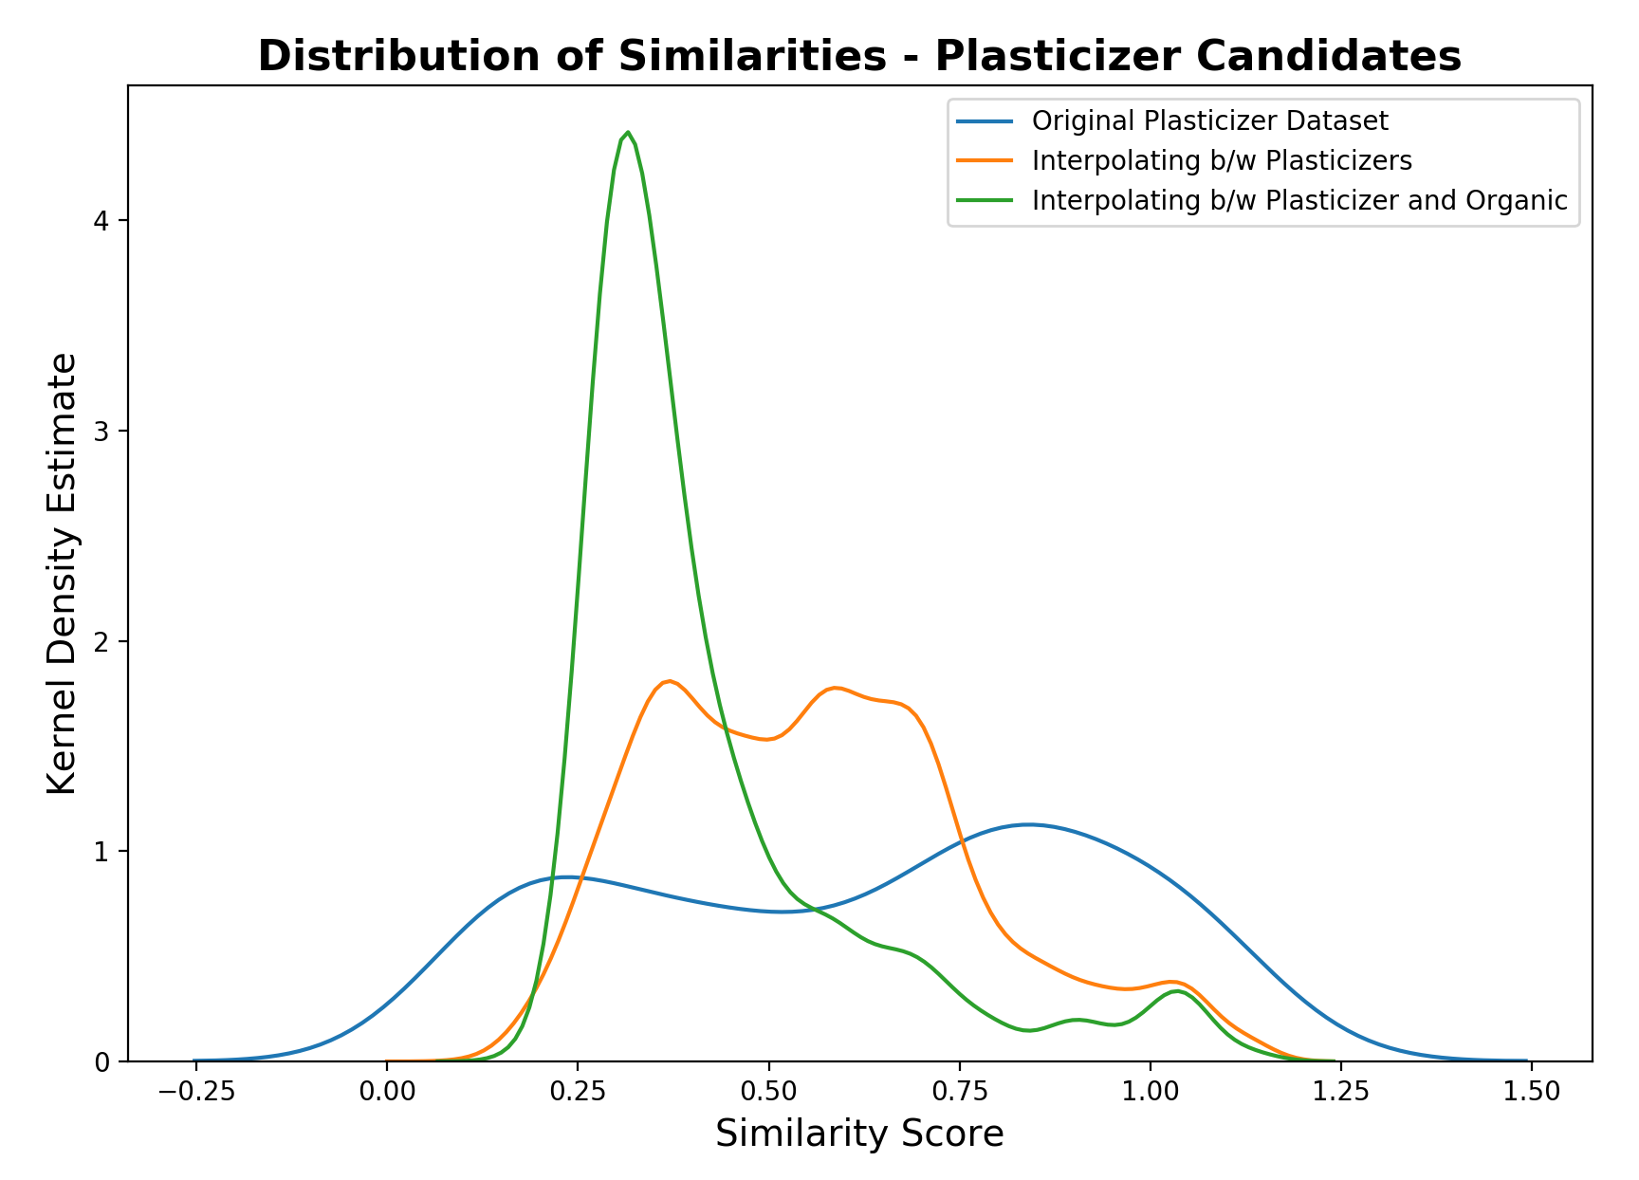
Results and conclusions – generative model
Diversity
Interpolating b/w known plasticizers and set of PubChem organic molecules leads to large increase in diversity of generated molecules
Realism can be improved by achieving better reconstruction on non-plasticizers and rewarding model for realism in loss function

Slide 23
Conclusions
Electrostatic topology and partition coefficient are important distinguishing features of plasticizers
A generative model can be built that allows for targeted exploration of discovery of new molecules likely to be plasticizers
Future works
Improve latent encodings of non-plasticizers to enable model to explore a wider variety of new molecules
Improve embedded property by including term that accounts for differences in quality b/w plasticizers
Evaluate synthesizability and toxicity of generated molecules

Slide 24
Appendix

Slide 25
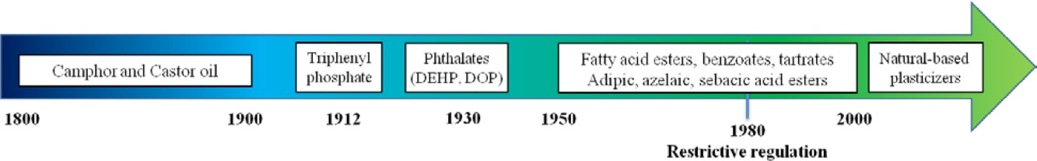
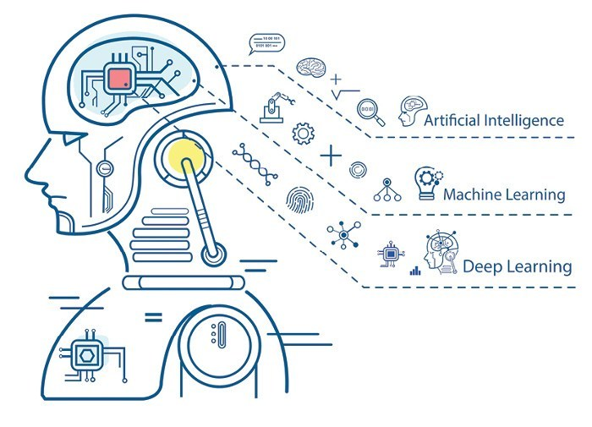
Accelerate R&D with data science
Currently most used category
Ideal plasticizer
Non-toxic
Bio-based
https://onlinelibrary.wiley.com/doi/10.1002/pola.27917
Machine learning sees thing from different aspects compared to human, providing different insights that accelerate research and discoveries.

Slide 26
Project use cases
In this project we are building a toolkit that could be used in :
Discover new correlations between a molecules’ chemical features and its effectiveness as a plasticizer
Generate new molecules of high potentials as plasticizers
Assess the toxicity and synthesizability of the new molecules

Slide 27

Data source and methods
Three databases were used:
Knovel
Plasticizers
PubChem
Organics
GDB-17
Chemical structures were converted to SMILES strings so that they are machine readable:
CCCCCOC(=O)CCC(=O)O
BrC1=C(NC(=O)C=C1)OCCOCCOC=N
C1=C(C2CO2)S(=O)(=O)C2=C(OCCO2)S1
BrC1=C2CC3(COCCO3)C(C=O)C2=CC=N1
C(=O)N1CCOC=O…
Chemical structures
SMILES strings
Machine learning

Slide 28
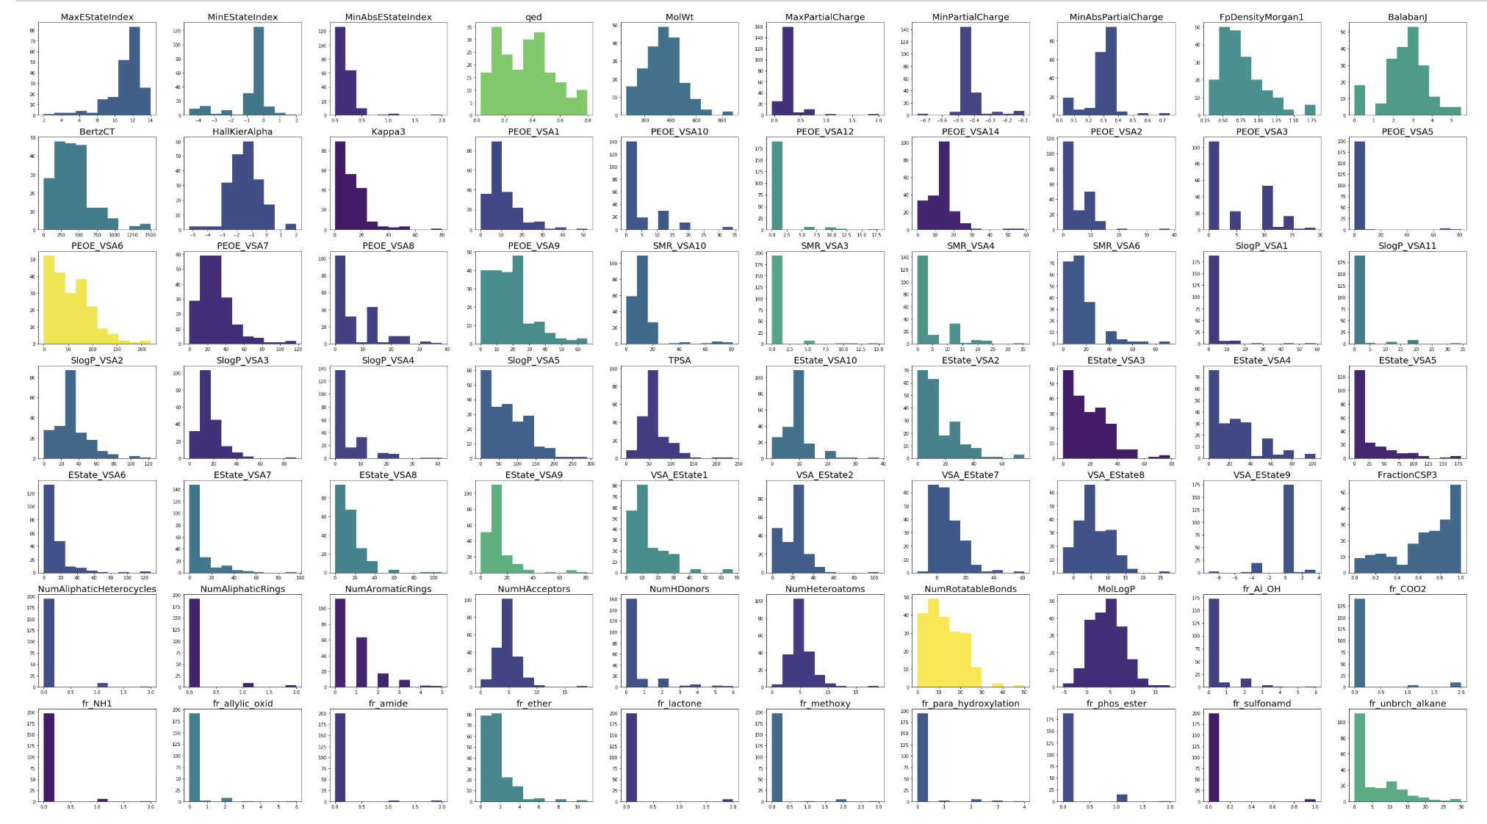
Data source and methods
We used RDKit to calculate molecular descriptor from inputted SMILES strings.
Distribution of chemical structural features

Slide 29
Data source and methods
Feature selection using Lasso Regression
195 features generated from RDKIT
15 features for optimized organics and plasticizers
Lasso Regression

Slide 30
Data source and methods
Feature selection using Lasso Regression

Slide 31
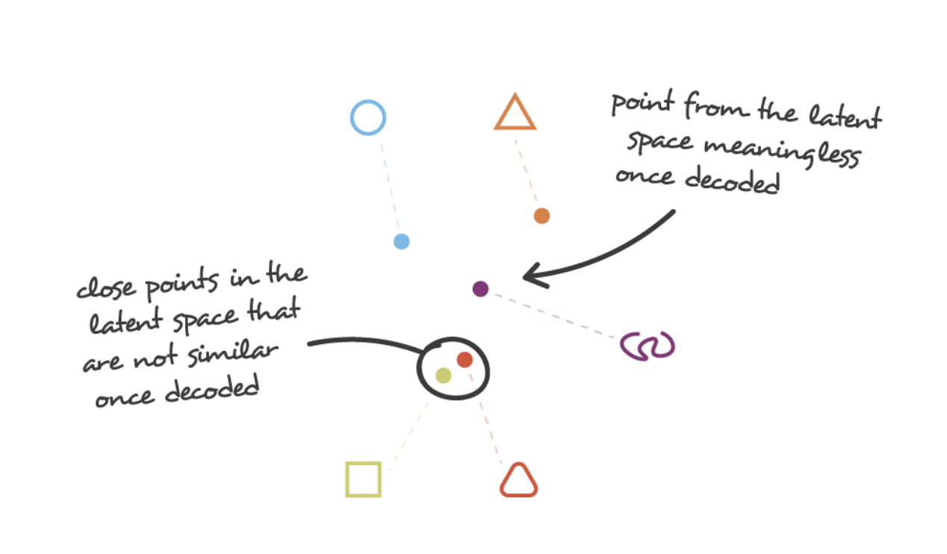
Data source and methods
Constructing continuous latent space using Variational Autoencoder (VAC)
Autoencoder
Discrete representations of molecules
CCCCCOC(=O)CCC(=O)O
BrC1=C(NC(=O)C=C1)OCCOCCOC=N
C1=C(C2CO2)S(=O)(=O)C2=C(OCCO2)S1
BrC1=C2CC3(COCCO3)C(C=O)C2=CC=N1
C(=O)N1CCOC=O…
OR
Method we used
SMILES strings
Variational Autoencoder
A multidimensional continuous representation

Slide 32
Data source and methods
Continuous representations of molecules allow us to automatically generate novel chemical structures by performing simple operations in the latent space, such as decoding random vectors.
https://pubs.acs.org/doi/pdf/10.1021/acscentsci.7b00572

Slide 33
Data source and methods
Evaluating the Loss Function
$$Loss=Reconstruction+KL Divergence+Property Prediction$$
Decoder
Reconstructed
SMILES
Encoder
SMILES
Backpropagation
*
KL divergence loss calculated
*
Reconstruction loss calculated

Slide 34
Data source and methods
Minimizing the loss function
Effect of beta on model performance
Effect of architecture on model performance

Slide 35
Results and conclusions – predictive model
We started with 195 features for organics and plasticizers.
After training the model with the nonzero coefficients, we obtained 15 features with optimized plasticizers and organics accuracies:

Slide 36
Results and conclusions – predictive model

Slide 37
Results and conclusions – predictive model

Slide 38
Results and conclusions – predictive model

Slide 39
Results and conclusions – predictive model

Slide 40
Results and conclusions – generative model
Sample Reconstructions
-----Index 1-----
Target CCCCC(CC)COC(=O)CCCCCC(C)C
Output CCCCC(CC)COC(=O)CCCCCC(C)C
-----Index 2-----
Target CC(C)COP(=O)(OCC(C)C)OCC(C)C
Output CC(C)COP(=O)(OCC(C)C)OCC(C)C
-----Index 3-----
Target CCCCOP(=O)(OCCCC)OCCCC
Output CCCCOP(=O)(OCCCC)OCCCC
-----Index 4-----
Target C1=CC=C(C(=C1)C(=O)O)N2C(=NC=N2)CC3=CC=C(C=C3)O
Output C1=CC=C(C(=C1)C(=O)N)C2=NC=C(=2)CC3=CC=C(C=C3)O
-----Index 5-----
Target CC1=CC(=C2C3=C1OC4(C=C3C5=C(C2=O)C(=CC(=C5)O)O)C(=O)NC(=CC6=C(NC7=CC=CC=C76)C(C)(C)C=C)C(=O)N4)O
Output CC1=CC(=O2C3=C1CC43C(C4C(=33C(=O)C5=C((=C5O5)O)C()O)OCC(CCC=C(CCCCCCCCC)O)O)O)CCCC=C(C=C(=O)OC)C)C
-----Index 6-----
Target C(C(CO)(CO)COCC(CO)(CO)CO)O
Output C(C(CO)(CO)COCC(CO)(CO)CO)O
-----Index 7-----
Target CCCCCCCCCCCCCCCCOC(=O)C
Output CCCCCCCCCCCCCCCCOC(=O)C
-----Index 8-----
Target CC1=NOC(=C1SC#N)N
Output CC1=C(C(=N1)1=C)N
-----Index 9-----
Target CCC(CC1=CC=C(C=C1)Cl)N
Output CCC(CC1=CC=C(C=C1)O)N
-----Index 10-----
Target CC1C(C2(C3C4C1(C5C=C(C(=O)C5(C(C6(C4O6)CO)O)O)C)OC(O3)(O2)C7=CC=CC=C7)C(=C)C)OC(=O)C=CC8=CC=CC=C8
Output CCN1CC2(C3C4CC(C5C=C(C(=O)C5(C(C6(C4O6)CO)O)O)C)OC(O3)(O2)C7=CC=CC=C7)C(=C)C)OC(=O)C=CC8CCC=CC=C8

Slide 41
Results and conclusions – generative model
Latent Space Reorganization

Slide 42
Results and conclusions – generative model
We analyzed the features for the new generated molecules and used Lasso Regression again for them.

Slide 43
Results and conclusions – generative model

Slide 44
Results and conclusions – generative model

Slide 45
Results and conclusions – generative model

